Slide 1

UE19CS204 – Web Technologies Mini Project
Project Title – Music app
Section - 'H'
Sonali Kadham - PES1UG19CS493
Sourabh Nutakki - PES1UG19CS494
Spurthy Skandan -PES1UG19CS501
GITHUB Link - https://github.com/sonali111-tech/Web-tech-project

Slide 2
Abstract
In any form of its application music expresses its own self. As it is said "Music is worth a thousand words".
A music app allows you to take your entire music collection wherever you go and listen to it whenever you please.
Our music app, allows the user to create a collection of songs, add onto it, pick any song from the existing list, edit any information at any point if needed, listen to the song and get a link to the song as well.
To perform this, we have used a MERN stack (React.js + Node.js + Express + MongoDB) CRUD Application example. The back-end server uses Node.js + Express for REST APIs, front-end side is a React client with React Router, Axios & Bootstrap.

Slide 3
Technologies Used
package.json contains 4 main modules: react, react-router-dom, axios & bootstrap.
.env configures port for this React CRUD App.
http-common.js initializes axios with HTTP base URL and headers.
express is for building the Rest apis
body-parser helps to parse the request and create the req.body object
cors provides Express middleware to enable CORS with various options.
mongoose is also used in the back end.
App is the container that has Router & navbar.
TutorialsList, Tutorial, AddTutorial are the 3 components.
TutorialDataService has methods for sending HTTP requests to the Apis.

Slide 4
Member Contributions
Functionalities

Slide 5
Member Contributions
Sonali- tutoriallist.component, http-common.js,index.js,App.css ,tutorial.controller,index.js,index.html
Sourabh- tutorial.component.js, App.js, tutorial.model.js, tutorial.routes.js
Spurthy- add-tutorial.component.js, index.js, server.js, db.config.js

Slide 6
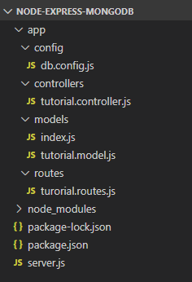
Back end
db.config.js exports configuring parameters for MongoDB connection & Mongoose
Express web server in server.js where we configure CORS, initialize & run Express REST APIs
Next, we add configuration for MongoDB database in models/index.js, create Mongoose data model in models/tutorial.model.js.
Tutorial controller in controllers.
Routes for handling all CRUD operations (including custom finder) in tutorial.routes.js.

Slide 7
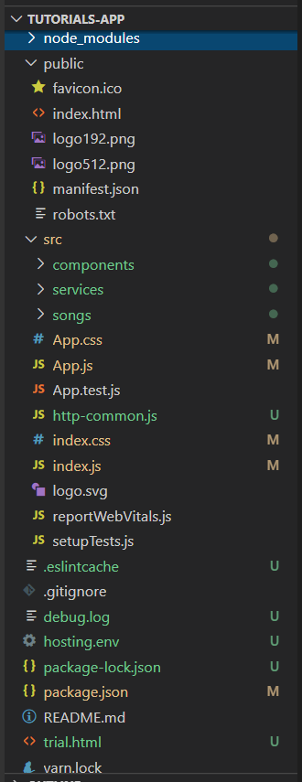
Front End
The App component is a container with React Router. It has navbar that links to routes paths.
TutorialsList component gets and displays Tutorials.
Tutorial component has form for editing Tutorial’s details based on :id.
AddTutorial component has form for submission new Tutorial.
These Components call TutorialDataService methods which use axios to make HTTP requests and receive responses.

